Slide 1
Group 4: FINAL prESENTATION Who Borrows in India?
Analysis of loan transactions based on social and economic factors using Debt and Investment Survey 2019

Slide 2
Overview
Dataset
Data analysis
Algorithms
Comparison
References

Slide 3
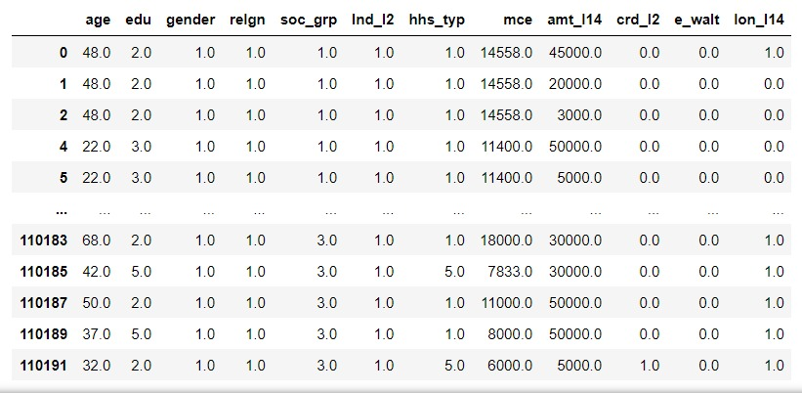
Data-Set
Household data was obtained from NSS(National Sample Survey)
Very huge dataset with 1,79,678 observations and 88 features
Features such as monthly consumer expenditure, amount of loan taken , and loan status.
Features such as religion and social group constitute social indicators for analysis.

Slide 4
Algorithms
To predict the credit card and e-wallet users depending on education level, age & gender
Logistic regression
Decision tree
Random forest classifier
Naïve bias
Bagging
Boosting
SVC
Voting classifier
Neural network
KNN
Stacking
Under-sampling RF

Slide 5
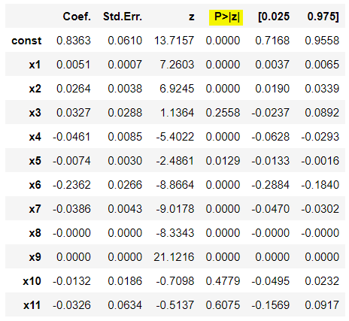
Multiple Logistic Regression
Independent features
Accuracy: 68.4%
Dependent features
Age
Gender
Education level
Religion
Social group
Land owned
House type
Credit card
E-wallet
Loan amount
Monthly expenditure
Loan repaid or not

Slide 6
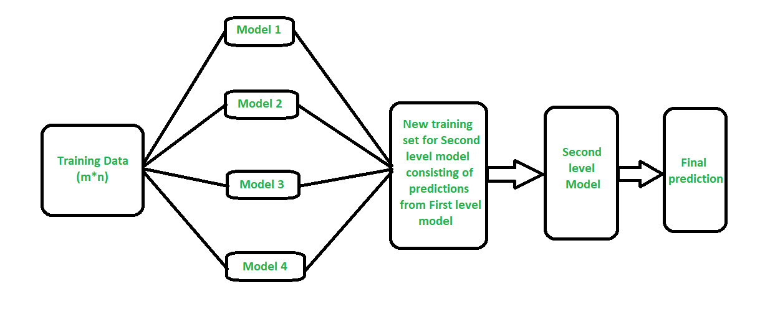
Stacking
Models used:
Logistic regression
KNN
Decision tree
Naïve bayes

Slide 7
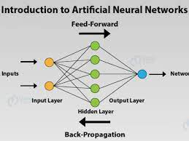
Neural networks

Slide 8
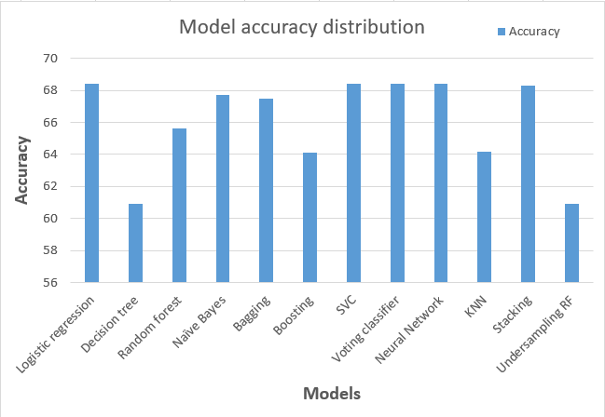
Comparison

Slide 9
Confusion matrix analysis
Decision T | Actual +ve | Actual -ve
Predic. +ve | 1689 | 2673
Predic. -ve | 2457 | 6297
R F C | Actual +ve | Actual -ve
Predic. +ve | 1597 | 1959
Predic. -ve | 2549 | 7011
Total: 7986
Total: 8608
Logistic R | Actual +ve | Actual -ve
Predic. +ve | 2 | 1
Predic. -ve | 4144 | 8969
Naïve Bias | Actual +ve | Actual -ve
Predic. +ve | 947 | 1038
Predic. -ve | 3199 | 7932
Total: 8971
Total: 8879

Slide 10
Most prominent feature
Monthly expenditure 31.1625 %
Loan amount 21.5179 %
Age 21.0929 %
Education 8.5614 %
Social group 5.2306 %
House type 4.4447 %
Credit card 2.6286 %
Religion 2.2659 %
Gender 1.6279 %
Land owned 1.0308 %
E-wallet 0.4368 %

Slide 11
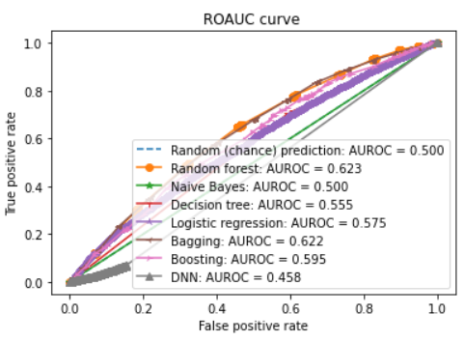
ROC-AUC analysis

Slide 12
References
Joseph Adwere-Boamah - Multiple logistic regression analysis of cigarette use among high school students, Journal of Case Studies in Education
Goyal, Anchal, and Ranpreet Kaur. "A survey on ensemble model for loan prediction." International Journal of Engineering Trends and Applications
“A study on predicting loan default based on the random forest algorithm” by Lin Zhu, Dafeng Qiu (IJETA) 3.1 (2016): 32-37.

